Slide 1
AJAX
Asynchronous JavaScript And XML

Slide 2
UNIT V
AJAX: Ajax Client Server Architecture-XML Http Request Object-Call Back Methods;
Web Services: Introduction- Java web services Basics – Creating, Publishing, Testing and Describing a Web services (WSDL)-Consuming a web service, Database Driven web service from an application – SOAP.

Slide 3
Asynchronous JavaScript And XML.
AJAX is not a new programming language, but a new way to use existing standards.
AJAX is the art of exchanging data with a server, and updating parts of a web page - without reloading the whole page.
AJAX just uses a combination of:
  A browser built-in XMLHttpRequest object (to request data from
a web server)
  JavaScript and HTML DOM (to display or use the data)

Slide 4
Asynchronous JavaScript And XML.
AJAX allows web pages to be updated asynchronously by exchanging data with a web server behind the scenes.
This means that it is possible to update parts of a web page, without reloading the whole page.

Slide 5
Asynchronous JavaScript And XML.
AJAX is a technique for creating fast and dynamic web pages.
Classic web pages, (which do not use AJAX) must reload the entire page if the content should change.
Examples of applications using AJAX: Google Maps, Gmail, Youtube, and Facebook tabs.
The term AJAX is coined on February 18, 2005, by Jesse James Garret in a short essay published a few days after Google released its Maps application.

Slide 6
AJAX is Based on Internet Standards
AJAX is based on internet standards, and uses a combination of:
  XMLHttpRequest object (to exchange data asynchronously with a server)
  JavaScript/DOM (to display/interact with the information)
  CSS (to style the data)
  XML (often used as the format for transferring data)
AJAX applications are browser- and platform- independent!

Slide 7
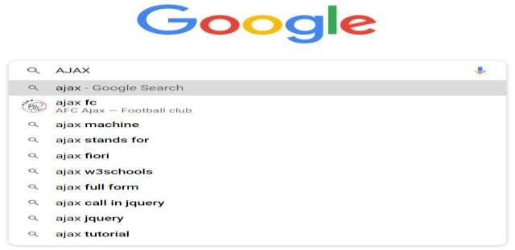
Google Suggest
AJAX was made popular in 2005 by Google, with Google Suggest.
Google Suggest is using AJAX to create a very dynamic web interface: When you start typing in Google's search box, a JavaScript sends the letters off to a server and the server returns a list of suggestions.

Slide 8
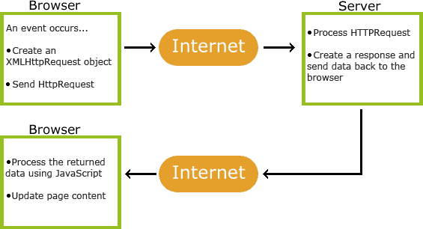
How AJAX Works

Slide 9
How AJAX Works
An event occurs in a web page (the page is loaded, a button is clicked)
An XMLHttpRequest object is created by JavaScript
The XMLHttpRequest object sends a request to a web server
The server processes the request
The server sends a response back to the web page
The response is read by JavaScript
Proper action (like page update) is performed by JavaScript

Slide 10
AJAX - The XMLHttpRequest Object
The keystone of AJAX is the XMLHttpRequest object.
All modern browsers support the XMLHttpRequest object.
The XMLHttpRequest object is used to exchange data with a server.
The XMLHttpRequest object can be used to exchange data with a server behind the scenes. This means that it is possible to update parts of a web page, without reloading the whole page.

Slide 11
AJAX - The XMLHttpRequest Object
All modern browsers (IE7+, Firefox, Chrome, Safari, and Opera) have a built-in XMLHttpRequest object.
Syntax for creating an XMLHttpRequest object:
variable=new XMLHttpRequest();
Old versions of Internet Explorer (IE5 and IE6) uses an ActiveX Object:
variable=new ActiveXObject("Microsoft.XMLHTTP");

Slide 12
XMLHttpRequest.response
The XMLHttpRequest response property returns the response's body content as an ArrayBuffer, Blob, Document, JavaScript Object, or DOMString, depending on the value of the request's responseType property.
var body = XMLHttpRequest.response;

Slide 13
var url = 'somePage.html'; //A local page
function load(url, callback) {
var xhr = new XMLHttpRequest();
xhr.onreadystatechange = function() { if (xhr.readyState === 4) { callback(xhr.response);
}
}
xhr.open('GET', url, true);
xhr.send('');
}

Slide 14
Send a Request To a Server
To send a request to a server, we use the open() and send() methods of the XMLHttpRequest object:
xmlhttp.open("GET","ajax_info.txt",true); xmlhttp.send();
Method | Description
open(method,url,async) | Specifies the type of request, the URL, and if the request should be handled asynchronously or not. method: the type of request: GET or POST url: the location of the file on the server async: true (asynchronous) or false (synchronous)
send(string) | Sends the request off to the server. string: Only used for POST requests

Slide 15
<html> <script>
function showHint(str)
{
var xmlhttp;
if (str.length==0)
{
document.getElementById("txtHint").innerHTML="";
return;
}
if (window.XMLHttpRequest)
{// code for IE7+, Firefox, Chrome, Opera, Safari xmlhttp=new XMLHttpRequest();
}
else
{// code for IE6, IE5
xmlhttp=new ActiveXObject("Microsoft.XMLHTTP");
}
xmlhttp.onreadystatechange=function()
{
if (xmlhttp.readyState==4 && xmlhttp.status==200)
{
document.getElementById("txtHint").innerHTML=xmlhttp.responseText;
}
}
xmlhttp.open("GET","gethint.php?q="+str,true); xmlhttp.send();
}

Slide 16
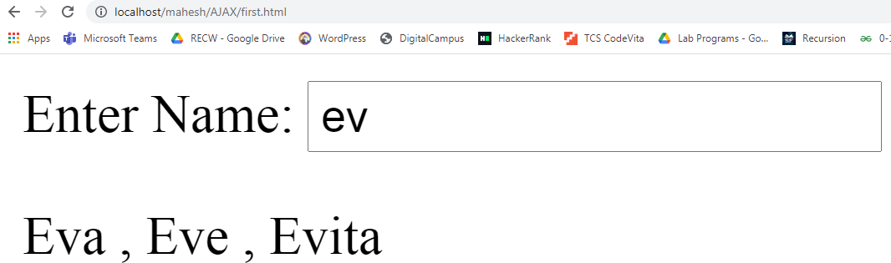
</script>
</head>
<form>
Enter Name: <input type="text" value="" onkeyup="showHint(this.value);">
</form>
<p>
<div id="txtHint"><b>User info will be listed here.</b></div>
</p>
</html>

Slide 17
XML Http Request Object
XMLHttpRequest Methods
abort()
Cancels the current request.
getAllResponseHeaders()
Returns the complete set of HTTP headers as a string.
getResponseHeader( headerName )
Returns the value of the specified HTTP header.
open( method, URL )
open( method, URL, async )
open( method, URL, async, userName )
open( method, URL, async, userName, password )
Specifies the method, URL, and other optional attributes of a request.
send( content )
Sends the request.
setRequestHeader( label, value )
Adds a label/value pair to the HTTP header to be sent. XMLHttpRequest Properties
onreadystatechange
An event handler for an event that fires at every state change.
readyState
The readyState property defines the current state of the XMLHttpRequest object.

Slide 18
XML Http Request Object
received from the server.
responseText
Returns the response as a string.
responseXML
Returns the response as XML. This property returns an XML document object, which can be examined and parsed using the W3C DOM node tree methods and properties.
status
Returns the status as a number (e.g., 404 for "Not Found" and 200 for "OK").
statusText
Returns the status as a string (e.g., "Not Found" or "OK").

Slide 19
onreadystatechange Property
Property | Description
onreadystatechange | Defines a function to be called when the readyState property changes
readyState | Holds the status of the XMLHttpRequest. 0: request not initialized 1: server connection established 2: request received 3: processing request 4: request finished and response is ready
status | 200: "OK" 403: "Forbidden" 404: "Page not found" For a complete list go to the Http Messages Reference
statusText | Returns the status-text (e.g. "OK" or "Not Found")

